Slide 1
Correlation
Prof. Andy Field

Slide 2
Aims
Measuring relationships
  Scatterplots
  Covariance
  Pearson’s correlation coefficient
Nonparametric measures
  Spearman’s rho
  Kendall’s tau
Interpreting correlations
  Causality
Partial correlations

Slide 3

What is a Correlation?
It is a way of measuring the extent to which two variables are related.
It measures the pattern of responses across variables.

Slide 4
Very Small Relationship
Notes:
Appreciation of Norwegian Black metal Band Dimmu Borgin against age

Slide 5
Positive Relationship

Slide 6
Negative Relationship

Slide 7
Measuring Relationships
We need to see whether as one variable increases, the other increases, decreases or stays the same.
This can be done by calculating the covariance.
  We look at how much each score deviates from the mean.
  If both variables deviate from the mean by the same amount, they are likely to be related.

Slide 9
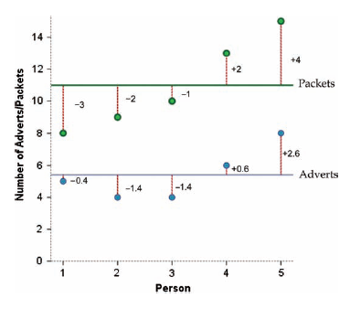

Slide 10
Revision of Variance
The variance tells us by how much scores deviate from the mean for a single variable.
It is closely linked to the sum of squares.
Covariance is similar – it tells is by how much scores on two variables differ from their respective means.

Slide 11
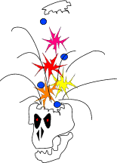
Variance
The variance tells us by how much scores deviate from the mean for a single variable.
It is closely linked to the sum of squares.

Slide 13
Covariance
Calculate the error between the mean and each subject’s score for the first variable (x).
Calculate the error between the mean and their score for the second variable (y).
Multiply these error values.
Add these values and you get the cross product deviations.
The covariance is the average cross-product deviations:

Slide 16
Problems with Covariance
It depends upon the units of measurement.
  E.g. the covariance of two variables measured in miles might be 4.25, but if the same scores are converted to kilometres, the covariance is 11.
One solution: standardize it!
  Divide by the standard deviations of both variables.
The standardized version of covariance is known as the correlation coefficient.
  It is relatively unaffected by units of measurement.

Slide 17
The Correlation Coefficient

Slide 18
The Correlation Coefficient

Slide 19
Correlation: Example
Anxiety and exam performance
Participants:
  103 students
Measures
  Time spent revising (hours)
  Exam performance (%)
  Exam Anxiety (the EAQ, score out of 100)
  Gender

Slide 20
Doing a Correlation with R Commander

Slide 21
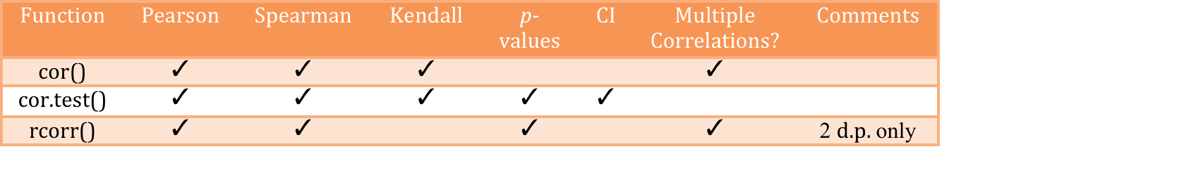
General Procedure for Correlations Using R
To compute basic correlation coefficients there are three main functions that can be used:
  cor(), cor.test() and rcorr().

Slide 22
Correlations using R
Pearson correlations:
  cor(examData, use = "complete.obs", method = "pearson")
  rcorr(examData, type = "pearson")
  cor.test(examData$Exam, examData$Anxiety, method = "pearson")
If we predicted a negative correlation:
  cor.test(examData$Exam, examData$Anxiety, alternative = "less"), method = "pearson")

Slide 23
Pearson Correlation Output
  Exam Anxiety Revise
  Exam 1.0000000 -0.4409934 0.3967207
  Anxiety -0.4409934 1.0000000 -0.7092493
  Revise 0.3967207 -0.7092493 1.0000000

Slide 24
Reporting the Results
Exam performance was significantly correlated with exam anxiety, r = −.44, and time spent revising, r = .40; the time spent revising was also correlated with exam anxiety, r = −.71 (all ps < .001).

Slide 25
Things to Know about the Correlation
It varies between -1 and +1
  0 = no relationship
It is an effect size
  ±.1 = small effect
  ±.3 = medium effect
  ±.5 = large effect
Coefficient of determination, r²
  By squaring the value of r you get the proportion of variance in one variable shared by the other.

Slide 26
Correlation and Causality
The third-variable problem:
  In any correlation, causality between two variables cannot be assumed because there may be other measured or unmeasured variables affecting the results.
Direction of causality:
  Correlation coefficients say nothing about which variable causes the other to change.

Slide 27
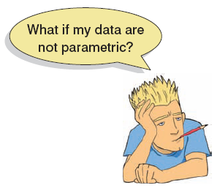
Non-parametric Correlation
Spearman’s rho
  Pearson’s correlation on the ranked data
Kendall’s tau
  Better than Spearman’s for small samples
World’s Biggest Liar competition
  68 contestants
  Measures
    Where they were placed in the competition (first, second, third, etc.)
    Creativity questionnaire (maximum score 60)

Slide 28
Spearman’s Rho
  cor(liarData$Position, liarData$Creativity, method = "spearman")
The output of this command will be:
  [1] -0.3732184
To get the significance value use rcorr() (NB: first convert the dataframe to a matrix):
  liarMatrix<-as.matrix(liarData[, c("Position", "Creativity")])
  rcorr(liarMatrix)
Or:
  cor.test(liarData$Position, liarData$Creativity, alternative = "less", method = "spearman")

Slide 29
  Spearman's Rho
  Output
  Spearman's rank correlation rho
  data: liarData$Position and liarData$Creativity
  S = 71948.4, p-value = 0.0008602
  alternative hypothesis: true rho is less than 0
  sample estimates:
  rho
  -0.3732184

Slide 30
  Kendall’s Tau (Non-parametric)
To carry out Kendall’s correlation on the World’s Biggest Liar data simply follow the same steps as for Pearson and Spearman correlations but use method = “kendall”:
  cor(liarData$Position, liarData$Creativity, method = "kendall")
  cor.test(liarData$Position, liarData$Creativity, alternative = "less", method = "kendall")

Slide 31
  Kendall’s Tau (Non-parametric)
The output is much the same as for Spearman’s correlation.
  Kendall's rank correlation tau
  data: liarData$Position and liarData$Creativity
  z = -3.2252, p-value = 0.0006294
  alternative hypothesis: true tau is less than 0
  sample estimates:
  tau
  -0.3002413

Slide 32
Bootstrapping Correlations
If we stick with our World’s Biggest Liar data and want to bootstrap Kendall’s tau, then our function will be:
  bootTau<-function(liarData,i) cor(liarData$Position[i], liarData$Creativity[i], use = "complete.obs", method = "kendall")
To bootstrap a Pearson or Spearman correlation you do it in exactly the same way except that you specify method = “pearson” or method = “spearman” when you define the function.

Slide 33
Bootstrapping Correlations Output
To create the bootstrap object, we execute:
  library(boot)
  boot_kendall<-boot(liarData, bootTau, 2000)
  boot_kendall
To get the 95% confidence interval for the boot_kendall object:
  boot.ci(boot_kendall)

Slide 34
Bootstrapping Correlations
To bootstrap a Pearson or Spearman correlation you do it in exactly the same way except that you specify method = “pearson” or method = “spearman” when you define the function.

Slide 35
Bootstrapping Correlations Output
The output below shows the contents of boot_kendall:
  ORDINARY NONPARAMETRIC BOOTSTRAP
  Call:
  boot(data = liarData, statistic = bootTau, R = 2000)
  Bootstrap Statistics :
  original bias std. error
  t1* -0.3002413 0.001058191 0.097663

Slide 36
Bootstrapping Correlations Output
The output below shows the contents of the boot.ci() function:
  BOOTSTRAP CONFIDENCE INTERVAL CALCULATIONS
  Based on 2000 bootstrap replicates
  CALL :
  boot.ci(boot.out = boot_kendall)
  Intervals :
  Level Normal Basic
  95% (-0.4927, -0.1099 ) (-0.4956, -0.1126 )
  Level Percentile BCa
  95% (-0.4879, -0.1049 ) (-0.4777, -0.0941 )

Slide 37
Partial and Semi-partial Correlations
Partial correlation:
  Measures the relationship between two variables, controlling for the effect that a third variable has on them both.
Semi-partial correlation:
  Measures the relationship between two variables controlling for the effect that a third variable has on only one of the others.

Slide 40
Doing Partial Correlation using R
The general form of pcor() is:
  pcor(c("var1", "var2", "control1", "control2" etc.), var(dataframe))
We can then see the partial correlation and the value of R² in the console by executing:
  pc
  pc^2

Slide 41
Doing Partial Correlation using R
The general form of pcor.test() is:
  pcor(pcor object, number of control variables, sample size)
Basically, you enter an object that you have created with pcor() (or you can put the pcor() command directly into the function):
  pcor.test(pc, 1, 103)

Slide 42
Partial Correlation Output
  > pc
  [1] -0.2466658
  > pc^2
  [1] 0.06084403
  > t(pc, 1, 103)
  $tval
  [1] -2.545307
  $df
  [1] 100
  $pvalue
  [1] 0.01244581

